Slide 1
Learning
We need that the machine is Learning from the data
Similar to Learning from experience in terms of human behavior
We can adjust and adapt to the new circumstances and learn new tricks
Terms : remembering, adapting, and generalizing
Remembering - recognizing that last time we were in this situation (saw this data) we tried out some particular action (gave this output) and it worked (was correct), so we’ll try it again, or it didn’t work, so we’ll try something different.
‹#›

Slide 2
Learning
Generalizing, is about recognizing similarity between different situations, so that things that applied in one place can be used in another
Reasoning and deduction : There has also been a lot of interest in making computers reason and deduce facts. This was the basis of most early Artificial Intelligence, and is sometimes known as symbolic processing because the computer manipulates symbols that reflect the environment.
In contrast, machine learning methods are sometimes called subsymbolic because no symbols or symbolic manipulation are involved.
‹#›

Slide 3
Learning
Machine Learning : making computers modify or adapt their actions (whether these actions are making predictions, or controlling a robot) so that these actions get more accurate, where accuracy is measured by how well the chosen actions reflect the correct ones.
Example :playing Scrabble (or some other game) against a computer.
ML is multi-disciplinary, merges ideas from neuroscience and biology, statistics, mathematics, and physics, to make computers learn.
‹#›

Slide 4
Learning
computational complexity is particularly important because we might want to use some of the methods on very large datasets, so algorithms that have high degree polynomial complexity in the size of the dataset (or worse) will be a problem.
The complexity is often broken into two parts: the complexity of training, and the complexity of applying the trained algorithm.
Training does not happen very often, and is not usually time critical, so it can take longer.
However, we often want a decision about a test point quickly, and there are potentially lots of test points when an algorithm is in use, so this needs to have low computational cost.
‹#›

Slide 5
Machine Learning Types
Supervised learning (classification)
A training set of examples with the correct responses (targets) is provided and, based on this training set, the algorithm generalizes to respond correctly to all possible inputs. This is also called learning from exemplars.
Supervision: The training data (observations, measurements, etc.) are accompanied by labels indicating the class of the observations
New data is classified based on the trained model
‹#›
Notes:
‹#›

Slide 6
Unsupervised learning (clustering)
Correct responses are not provided, but instead the algorithm tries to identify similarities between the inputs so that inputs that have something in common are categorized together.
The statistical approach to unsupervised learning is known as density estimation.
The class labels of training data is unknown
‹#›

Slide 7
Machine Learning Types
Reinforcement learning
This is somewhere between supervised and unsupervised learning.
The algorithm gets told when the answer is wrong, but does not get told how to correct it. It has to explore and try out different possibilities until it works out how to get the answer right.
Reinforcement learning is sometime called learning with a critic because of this monitor that scores the answer
‹#›
Notes:
‹#›

Slide 8
Machine Learning Types
Evolutionary learning
Biological evolution can be seen as a learning process: biological organisms adapt to improve their survival rates and chance of having offspring in their environment.
We’ll look at how we can model this in a computer, using an idea of fitness, which corresponds to a score for how good the current solution is.
‹#›
Notes:
‹#›

Slide 9
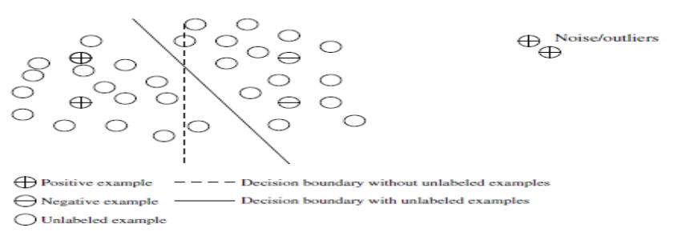
Machine Learning Types
Semi-Supervised learning
Make use of both labeled and unlabeled examples when learning a model. In one approach, labeled examples are used to learn class models and unlabeled examples are used to refine the boundaries between classes.
‹#›
Notes:
‹#›

Slide 10
Machine Learning Types
Active Learning
Lets users play an active role in the learning process.
An active learning approach can ask a user (e.g., a domain expert) to label an example, which may be from a set of unlabeled examples or synthesized by the learning program.
The goal is to optimize the model quality by actively acquiring knowledge from human users, given a constraint on how many examples they can be asked to label.
‹#›
Notes:
‹#›

